Slide 1
AUTISM SPECTRUM DISORDER DETECTION
A COMPARATIVE STUDY OF NATURE INSPIRED ALGORITHMS FOR AUTISM SPECTRUM DISORDER(ASD) DETECTION
By
Vinayak Kukreja and Rajas Deshpande

Slide 2
PROBLEM STATEMENT
Perform a comparative study of five nature-inspired optimization algorithms for detecting autism in young adults.
The five algorithms used are -
Bat Algorithm
Cat Swarm Optimization
Cuckoo Optimization Algorithm
Firefly Algorithm
Grey Wolf Optimization
The results of all these optimization algorithms is compared with Backpropagation algorithm to find out which algorithm suits the best for Autism detection

Slide 3
APPROACH
What is Autism Spectrum Disorder?
Autism Spectrum Disorder (ASD) is a condition related to brain development that impacts how a person perceives and socializes with other, causing problems in social interaction and communication.
ASD typically begins in early childhood and can show a wide range of symptoms and severity.
Till now, there is no cure for ASD, but early treatment can make a big difference in the lives of many children.

Slide 4
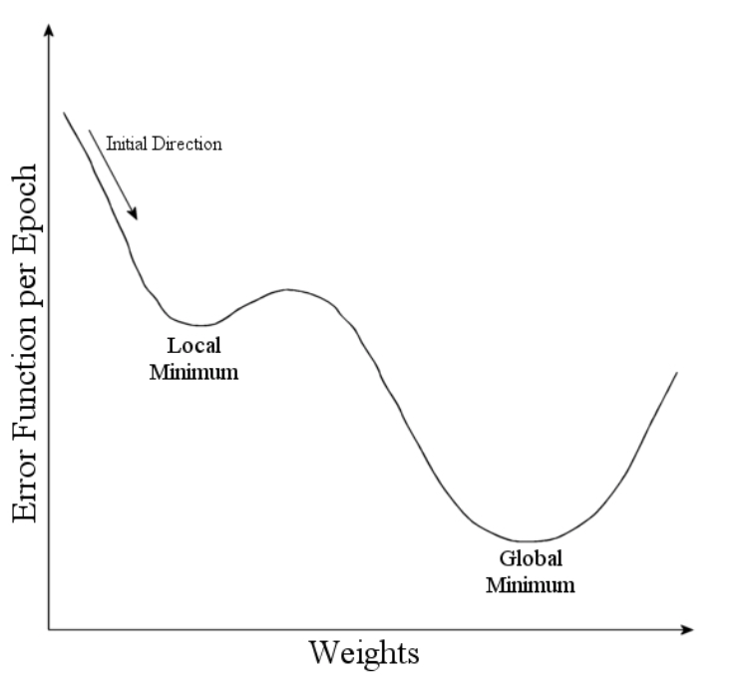
APPROACH
Why use nature inspired algorithms?
Back-propagation can be used for such an application but it has a major drawback of getting stuck in a local minima.
For detecting ASD, the results needs to be accurate and thus the nature-inspired algorithms would help widen the search space and eventually provide the best global solution rather than a local solution.

Slide 5
APPROACH
Dataset analysis and preprocessing
The Autism Spectrum Disorder (ASD) screening dataset has been used for detecting autism in young adults.
This dataset is labelled and open source and can be obtained from the UCI machine learning repository - http://archive.ics.uci.edu/ml/machine-learning-databases/00426/
The data has been pre-processed by removing unwanted features and has been converted to numerical format.
The following features are considered for detection of ASD -
A1-A10 Scores : These are some answers given by the people to certain questions
Gender : 0 - Female, 1 - Male
Jaundice : 0 - False, 1 - True
PDD : 0- False, 1 - True
Age range
ASD Class label
There are a total of 1100 records and 17 features.

Slide 6
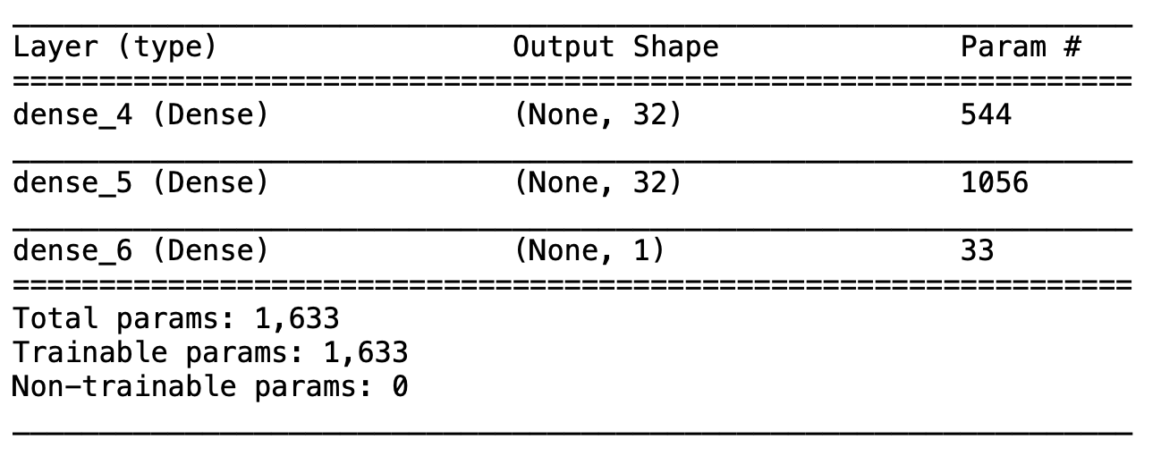
APPROACH
Neural Network Model and Analysis
A three-layered neural network model has been designed with 32 neurons in the first two layers and 1 neuron in the output layer.
The output layer will basically provide a predicted label which will be either 0 (does not have ASD) or 1 (has ASD).
The major goal is to find the best weights and biases for the network so that the model give the highest accuracy.
All the nature-based algorithms that are going to be explained in the next few slides will provide a best global solution and this solution will be shaped accordingly to match the weights and biases of the neural network model
Accordingly, the metrics of all the models will be calculated to find out which algorithm is most suited for this application.

Slide 7
RESOURCES USED
We have used a python library called “SwarmPackagePy” which is a library for swarm optimization algorithms.
This library supports fourteen optimization algorithms which include Grey Wolf Optimization, Bat Algorithm, Firefly Algorithm, Cuckoo Optimization Algorithm and Cat Swarm Optimization Algorithm.
These are the algorithms that we have used for detection of ASD and compared their efficiency against each other.

Slide 8
IMPLEMENTATION
Nature Inspired Algorithms
Optimization algorithms based on Swarm Intelligence were developed for simulating intelligent behavior of animals.
Nature Inspired Algorithms are a sub-category of Computational Intelligence which is a branch of Artificial Intelligence.
We are here using five nature inspired algorithms that help us detect Autism Spectrum Disorder and we are comparing the results obtained by these algorithms with each other.

Slide 9
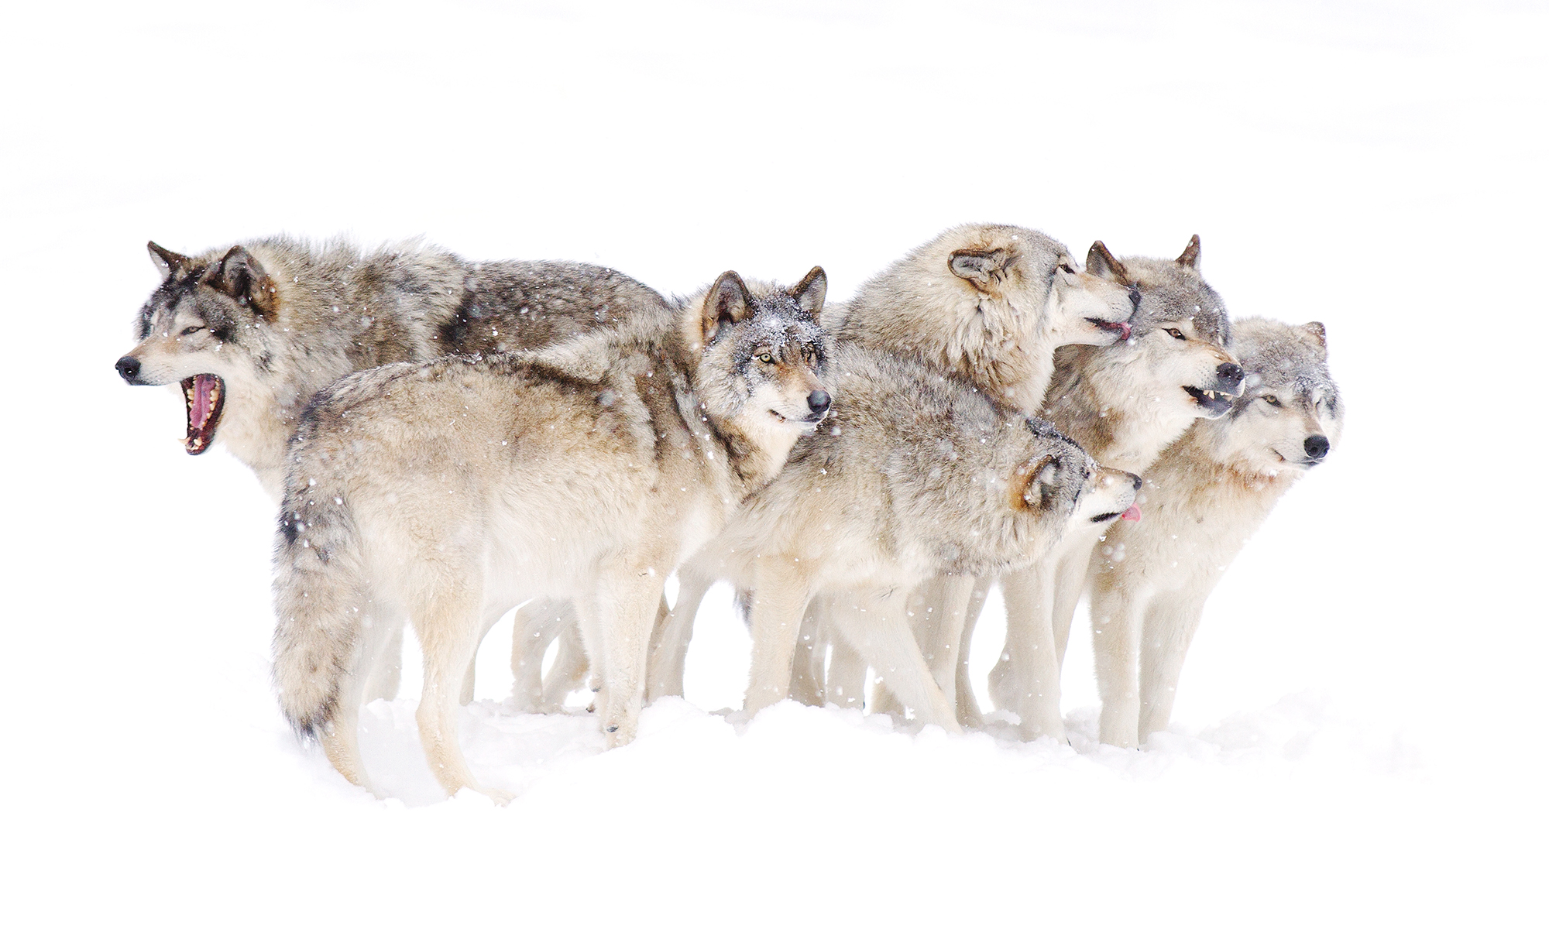
GREY WOLF OPTIMIZATION

Slide 10
IMPLEMENTATION
Grey Wolf Optimization
The Grey Wolf Optimization algorithm mimics the leadership hierarchy and hunting mechanism of gray wolves in nature. Wolves live in a pack. The average pack consists of a family of 5–12 animals. wolves have strict social hierarchy which is represented by the division of a pack into four levels: alpha, beta, delta, and omega.
Alpha wolves are the leaders of their pack. They are responsible for making decisions, but sometimes alphas can obey to other wolves of the pack.
Beta wolves help alphas make decisions, every beta is a candidate to become an alpha if an alpha has died or aged. A beta respects an alpha and transfers commands to the pack, ensures discipline among inferior wolves and provides a feedback from the pack to an alpha.
Delta wolves have to submit to alphas and betas, but they dominate the omega.
Finally, omega wolves have to obey all other wolves. Sometimes they play a role of caretakers or scapegoats.

Slide 11
IMPLEMENTATION
Grey Wolf Optimization
Gray wolf hunting has three main phases:
Tracking, chasing, and approaching the prey
Pursuing, encircling, and harassing the prey until it stops moving
Attack towards the prey
Mathematical model:
In mathematical model of the social hierarchy of wolves is mapped to the fittest solution.
The fittest solution is considered to be the alpha.
Beta and delta are the second and third best solutions respectively.
The rest of the candidate solutions are assumed to be omega.
Alpha, beta and delta lead the hunting (optimization) and omega wolves follow these three wolves.

Slide 12
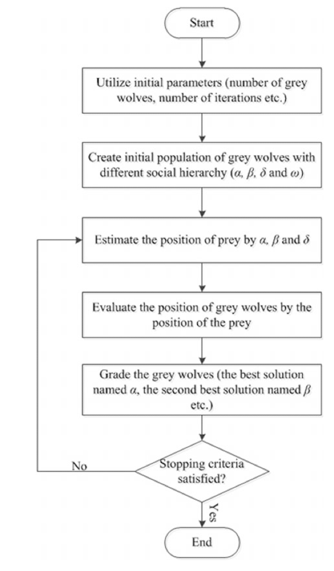
IMPLEMENTATION
Grey Wolf Optimization
Decision Variable | Grey Wolf
Solution | Position of grey wolf
Old Solution | Old position of grey wolf
New Solution | New position of grey wolf
Best Solution | Position of prey
Fitness Function | Distance between grey wolf and prey
Initial Solution | Initial random position of grey wolf
Process of Generating New Solutions | Hunting operators, i.e., encircling and attacking prey

Slide 13
IMPLEMENTATION
Grey Wolf Optimization
BEGIN
Initialize randomly the gray wolf population
Find 1st, 2nd and 3rd best agents (α, β, δ)
Set global best agent to the 1st best agent
Calculate the fitness of each search agent
WHILE count < max number of iterations
FOR each search agent
Update the position of the current search agent
END FOR
Update α, β and δ
Calculate the fitness of all search agents
Update the best search agent, the 2nd best search agent, and the 3rd best search agent
ADD 1 to count
END WHILE
RETURN the best search agent
END

Slide 14

BAT ALGORITHM

Slide 15
IMPLEMENTATION
Bat Algorithm
The Bat Algorithm is based on the bats echolocation ability.
By using echolocation bats can detect their food and preys and even distinguish between the different kinds of insects in the darkness.
A bat emits a loud sound and listens to the echo which is created from the sound reflection from the surrounding objects.
Sounds emitted by a bat are vary in properties and can be used depending on the hunting strategy.
Each sound impulse lasts from 8 to 10 milliseconds and has constant frequency between 25 and 150 KHz.
A bat can emit from 10 to 20 of supersonic impulses per second, an impulse lasts from 5 to 20 milliseconds. The number of signals emitted by a bat can be increased during a hunt to 200.

Slide 16
IMPLEMENTATION
Bat Algorithm
The Bat Algorithm uses the following principles:
A bat uses echolocation for distance estimation and "knows" the difference between the food/prey and an obstacle
Bats fly randomly with a velocity of νi in the position xi, fixed frequency fmin, variable wavelength λ and loudness A0 for the search of a prey. They can automatically adjust the wave length (or frequency) of emitted sound impulse and level of emission r ∈ [0, 1] depending on the proximity to the prey.
While the loudness can be changed by different means we assume that the loudness vary from big positive value A0 to minimum constant Amin. In addition to these simplified principles, let's use the next approximations: frequency f from the segment [fmin, fmax] corresponds to the wavelength segment [λmin, λmax]. For instance, a frequency segment [20 KHz, 500 KHz] corresponds to wavelength segment [0.7 mm, 17 mm].
The loudness usually decreases once a bat has found its prey, while the pulsation rate increases
A new solution is locally generated using random walk once a solution has been selected among the current best solutions. This is the local search part (random fly) of the BA.

Slide 17
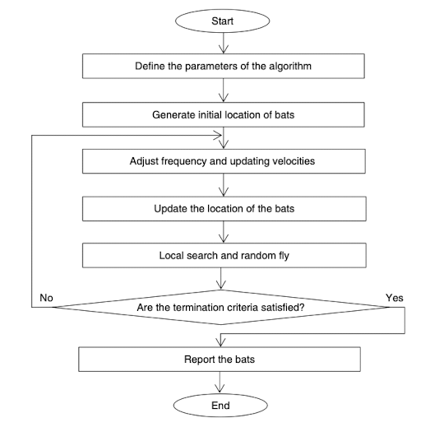
IMPLEMENTATION
Bat Algorithm
Decision Variable | Position of bat in any dimension
Solution | Position of bat
Old Solution | Old position of bat
New Solution | New position of bat
Best Solution | Best bat
Fitness Function | Distance with food
Initial Solution | Random Bat
Process of Generating New Solutions | Fly bats

Slide 18
IMPLEMENTATION
Bat Algorithm
BEGIN
Initialize the bat population xi (i= 1, 2, ..., n) and vi
Define pulse frequency fi at xi
Initialize pulse rates ri and the loudness Ai
WHILE count < max number of iterations
Generate new solutions by adjusting frequency, and updating velocities and locations/solutions
IF rand > ri
Select a solution among the best solutions
Generate a local solution around the selected best solution
END IF
Generate a new solution by flying randomly
IF rand < Ai AND f(xi) < f(x*)
Accept the new solutions
Increase ri and reduce Ai
END IF
Rank the bats and find the current best x*
END WHILE
Post-process results and visualization

Slide 19

FIREFLY ALGORITHM

Slide 20
IMPLEMENTATION
Firefly Algorithm
There are about 2000 firefly species, most of which produce short and rhythmic flashes.
Usually a particular species exhibits a unique flashing pattern.
The flashing light is generated by bioluminescence.
It is considered that the main function of flashes are to attract fireflies of the opposite sex, evade predators and attract potential preys.
A signal flash can communicate to a predator that a firefly has a bitter taste.

Slide 21
IMPLEMENTATION
Firefly Algorithm
The Firefly Algorithm is based on two important things: the change in light intensity and attractiveness. For simplicity, it is assumed that the attractiveness of a firefly is defined by its brightness which is connected with the objective function.
The algorithm utilizes the following firefly behavior model:
All fireflies are able to attract each other independently of their gender;
A firefly attractiveness for other individuals is proportional to its brightness.
Less attractive fireflies move in the direction of the most attractive one.
As the distance between two fireflies increases, the visible brightness of the given firefly for the other decreases.
If a firefly sees no firefly that is brighter than itself, it moves randomly.

Slide 22
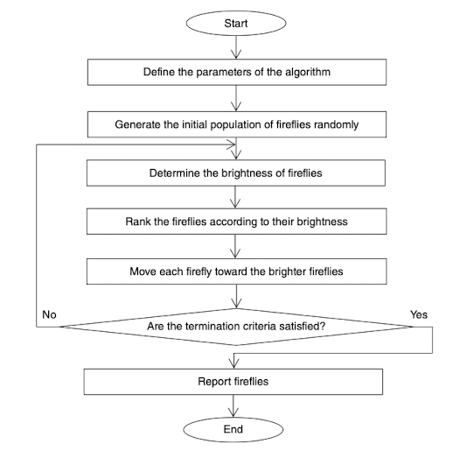
IMPLEMENTATION
Firefly Algorithm
Decision Variable | Position of firefly in each dimension
Solution | Position of firefly
Old Solution | Old position of firefly
New Solution | New position of firefly
Best Solution | Best firefly
Fitness Function | Brightness
Initial Solution | Random firefly
Process of Generating New Solutions | Movement of firefly

Slide 23
IMPLEMENTATION
Firefly Algorithm
Begin
Input the parameters of the algorithm and initial data
Generate M initial possible solutions randomly
While (the termination criteria are not satisfied)
Determine fitness value of all solutions
Sort all solutions according to their fitness values
For k = 1 to M
For j = 1 to M
If F(Xj) is better than F(Xk)
Move the solution k toward the solution j
End if
Next j
Next k
End while
Report all solutions
End

Slide 24
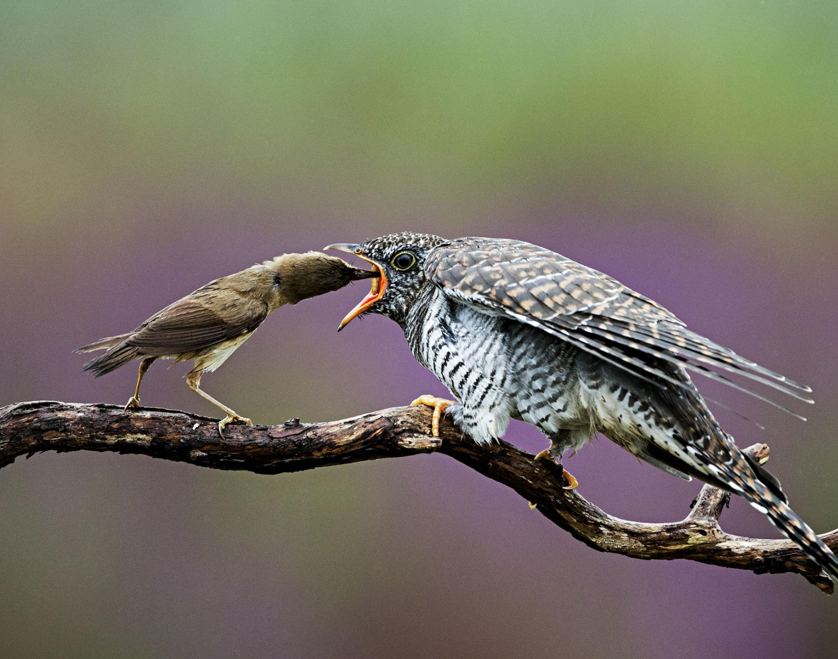
CUCKOO OPTIMIZATION ALGORITHM

Slide 25
IMPLEMENTATION
Cuckoo Optimization Algorithm
The algorithm was inspired by cuckoo bird’s lifestyle, egg laying features, and breeding technique.
This as other evolutionary approaches start off with an initial population and this population consists of mature cuckoos and eggs.
Cuckoo being a brood parasite i.e. birds that have detached themselves from the challenge of nest making for survival and evading predators, lay their eggs in other specie’s nests and hence uses a cunning way to raise their families.
A mother cuckoo lays eggs in hosts nest and destroys the host’s eggs and flies away from the location fast and the caring for the egg is left to the host species. This process takes hardly ten seconds.

Slide 26
IMPLEMENTATION
Cuckoo Optimization Algorithm
Therefore, they make other’s nests parasitized by their own eggs and mimic the color and the patterns of the existing eggs carefully so that the new eggs in the nest looks like the previous eggs. Each female cuckoo is specialized for a certain host species.
Some of the birds recognize cuckoos’ eggs and either they throw the eggs out of the nest or completely leave the nest and build a new one.
Cuckoo eggs hatch earlier than their host’s eggs. In most cases, a cuckoo chick throws the host’s eggs or the host’s chicks out of the nest.
A cuckoo chick makes the host provide a food suitable to its growth and beg for food again and again.

Slide 27
IMPLEMENTATION
Cuckoo Optimization Algorithm
COA starts with an initial population (population of cuckoos). These cuckoos have got some eggs that will be laid in other species’ nests. Some of these eggs that look like the host’s eggs are more probable to be raised and turned into cuckoos. Other eggs are detected by the host and are demised.
The rate of the raised eggs shows the suitability of the area. If there are more eggs to be survived in an area, there is more profits to that area. Thus, the situation in which more eggs are survived will be a parameter for the cuckoos to be optimized.
Cuckoos search for the best area to maximize their eggs’ life lengths. After hatching and turning into mature cuckoos, they form societies and communities. Each community has its habitat to live. The best habitat of all communities will be the next destination for cuckoos in other groups.

Slide 28
IMPLEMENTATION
Cuckoo Optimization Algorithm
All groups immigrate to the best current existing area. Each group will be the resident in an area near the best current existing area. An egg laying radius (ELR) will be calculated regarding the number of eggs each cuckoo lay and its distance from the current optimized area.
Afterwards, cuckoos start laying eggs randomly in the nests within their egg laying radii. This process continues until reaching the best place for egg laying (a zone with the most profit). This optimized zone is the place in which the maximum number of cuckoos gathers together.

Slide 29
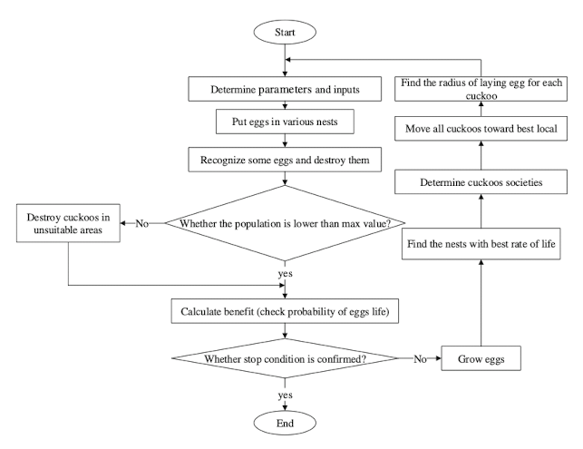
IMPLEMENTATION
Cuckoo Optimization Algorithm
Decision Variable | Cuckoo habitat
Solution | Habitat
Old Solution | Old habitat
New Solution | New habitat
Best Solution | Habitat with best rate of life
Fitness Function | Distance between best habitat and recent habitat
Initial Solution | Random eggs for all cuckoos
Process of Generating New Solutions | Emigration cuckoos toward best area

Slide 30
IMPLEMENTATION
Cuckoo Optimization Algorithm
Begin
Define the number of habitats by generating Xi for i =. 1, 2, 3,…., N
Determine the upper and lower limits of parameters of the optimization problem (varhi, varlow)
Consider the maximum number of cuckoos(Nmax)
Specify the maximum and minimum number of eggs(Emax, Emin)
Specify the maximum number of iterations(Itermax)
While(Stop criterion is not satisfied)
Define some cuckoos and assign some eggs to each cuckoo
Calculate the radius of laying eggs for each cuckoo(ELR)
Consider egg position or population(Xi,new) for each cuckoo in ELR
If the population is lower than the minimum number of cuckoos(Xi,new < Nmax)
Evaluate the fitness function of each egg(Fx)
Else
Destroy cuckoos in unsuitable areas
End if
End while
End

Slide 31
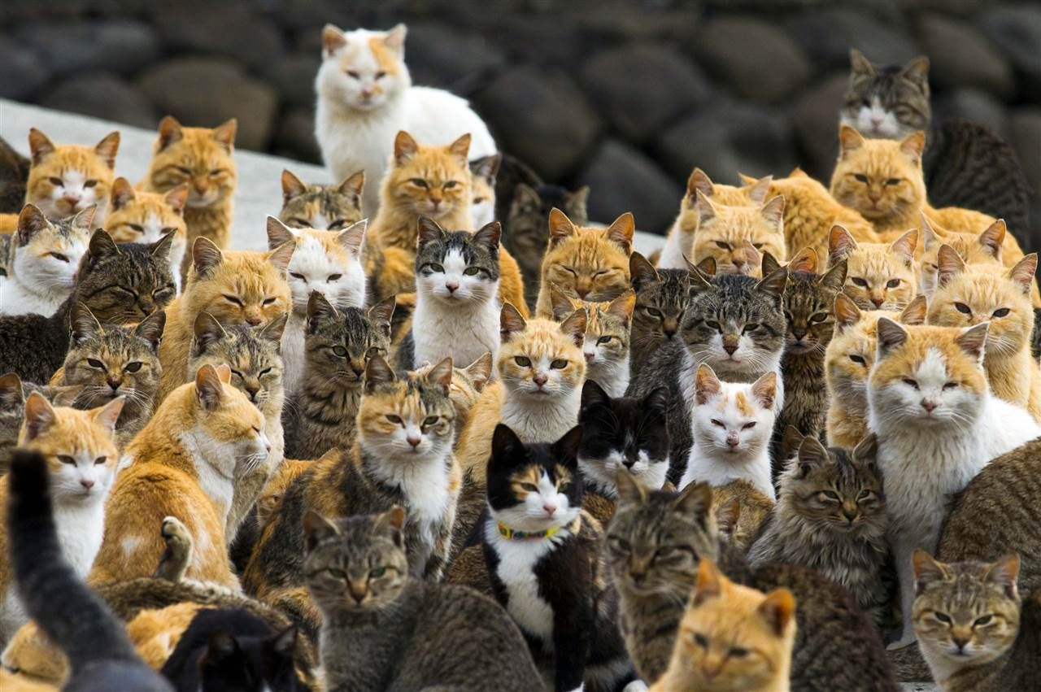
CAT SWARM OPTIMIZATION

Slide 32
IMPLEMENTATION
Cat Swarm Optimization
Despite spending most of their time in resting, cats have high alertness and curiosity about their surroundings and moving objects in their environment.
Compared to the time dedicated to their resting, they spend too little time on chasing preys to conserve their energy.
Inspired by this hunting pattern, CSO was developed with two modes: “seeking mode” for when cats are resting and “tracing mode” for when they are chasing their prey.
In CSO, a population of cats are created and randomly distributed in the M-dimensional solution space, with each cat representing a solution. This population is divided into two subgroups.

Slide 33
IMPLEMENTATION
Cat Swarm Optimization
The cats in the first sub- group are resting and keeping an eye on their surroundings (i.e., seeking mode), while the cats in the second subgroup start moving around and chasing their preys (i.e., tracing mode).
The mixture of these two modes helps CSO to move toward the global solution in the M-dimensional solution space.
Since the cats spend too little time in the tracing mode, the number of the cats in the tracing subgroup should be small. This number is defined by using the mixture ratio (MR) which has a small value.
After sorting the cats into these two modes, new positions and fitness functions will be available, from which the cat with the best solution will be saved in the memory. These steps are repeated until the stopping criteria are satisfied

Slide 34
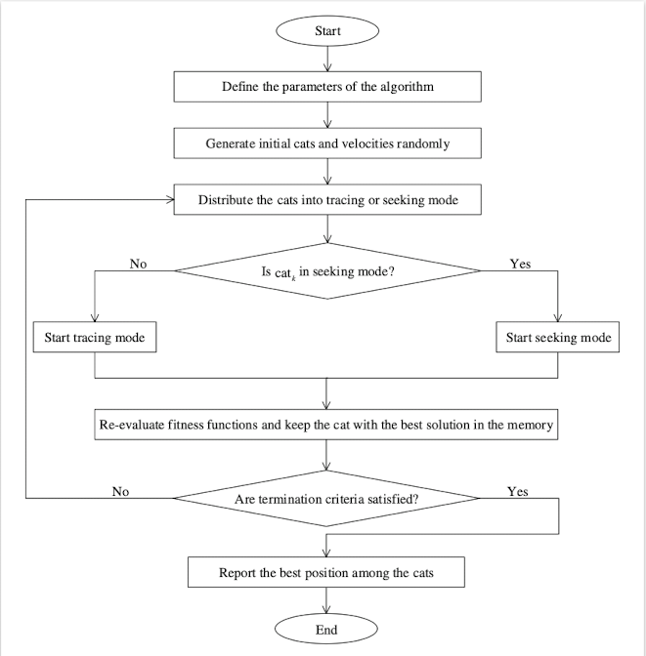
IMPLEMENTATION
Cat Swarm Optimization
Decision Variable | Cat’s position in each dimension
Solution | Cat’s Position
Old Solution | Old position of cat
New Solution | New position of cat
Best Solution | Any cat with the best fitness
Fitness Function | Distance between cat and prey
Initial Solution | Random position of cats
Process of Generating New Solutions | Seeking and tracing a prey

Slide 35
IMPLEMENTATION
Cat Swarm Optimization
Begin
Input parameters of the algorithm and the initial data
Initialize the cat population Xi (i = 1, 2, ... , n), v, and SPC
While (the stop criterion is not satisfied or I < Imax)
Calculate the fitness function values for all cats and sort them
Xg= cat with the best solution
For =1:N
If SPC = 1
Start seeking mode
Else
Start tracing mode
End if
End for i
End while
Post-processing the results and visualization
End

Slide 36
RESULTS
Metrics Analysis
Sr No. | Algorithm | Accuracy | MSE | Precision | Recall | Runtime
1 | Bat Algorithm | 92.7% | 0.07 | 0.93 | 0.97 | 16.14 mins
2 | Cat Algorithm | 83.4% | 0.16 | 0.87 | 0.87 | 6:03 mins
3 | Grey Wolf Optimization | 94.5% | 0.05 | 0.96 | 0.95 | 6:45 mins
4 | Cuckoo Search Optimization | 88.6% | 0.11 | 0.92 | 0.90 | 28:08 mins
5 | Firefly Algorithm | 85.9% | 0.14 | 0.87 | 0.92 | 4.5 hrs
6 | Particle Swarm Optimization | 97% | 0.03 | 0.99 | 0.98 | 6:03 mins
7 | Back Propagation | 98% | 0.02 | 0.99 | 0.98 | 11:17 mins

Slide 37
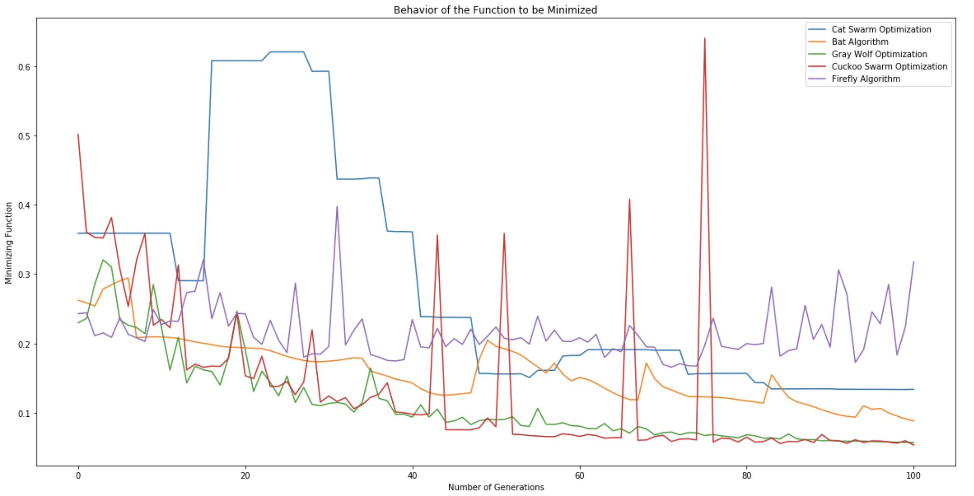
RESULTS
Behavior of Minimization Function

Slide 38
CONCLUSION
Based on the metric results and the behavior of minimization function, it can be concluded that back propagation algorithm was the best fit algorithm for this application.
It found the best global solution and the model gave an accuracy of almost 98%.
The best algorithm amongst the nature-inspired algorithms was the grey wolf optimization algorithm which gave an accuracy of almost 94%.

Slide 39
Thank You

